Slide 1
User Acquisition in Legendary Universe: H2 Insights
A concise overview of key metrics and trends (July–December 2023)
01
Acquisition Highlights (H2 2023)
02
User Acquisition Over Time
03
What the Data Tells Us
04
Looking Ahead

Slide 2
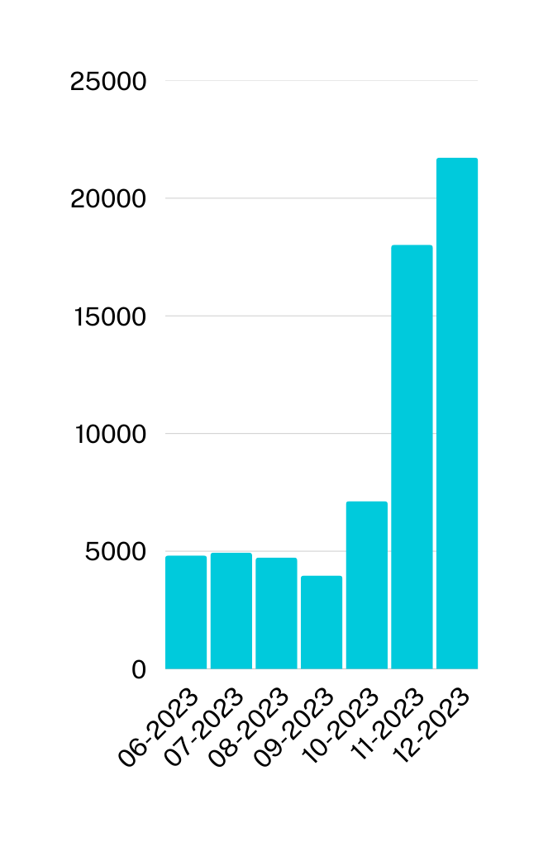
Acquisition Highlights (H2 2023)
65640
$2165.29
Total Accounts Opened
Average Cost per Acquisition (Account Opened)
$142,129,372.66
Total Marketing Spend
$94438.12
Average Cost per Acquisition (First Deposit)
1505
Total First Deposits

Slide 3
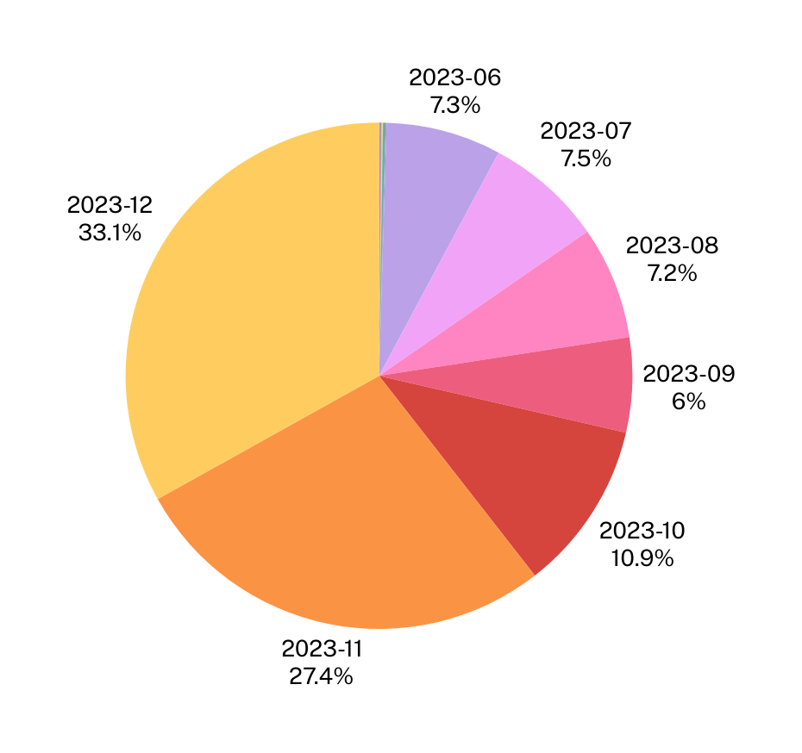
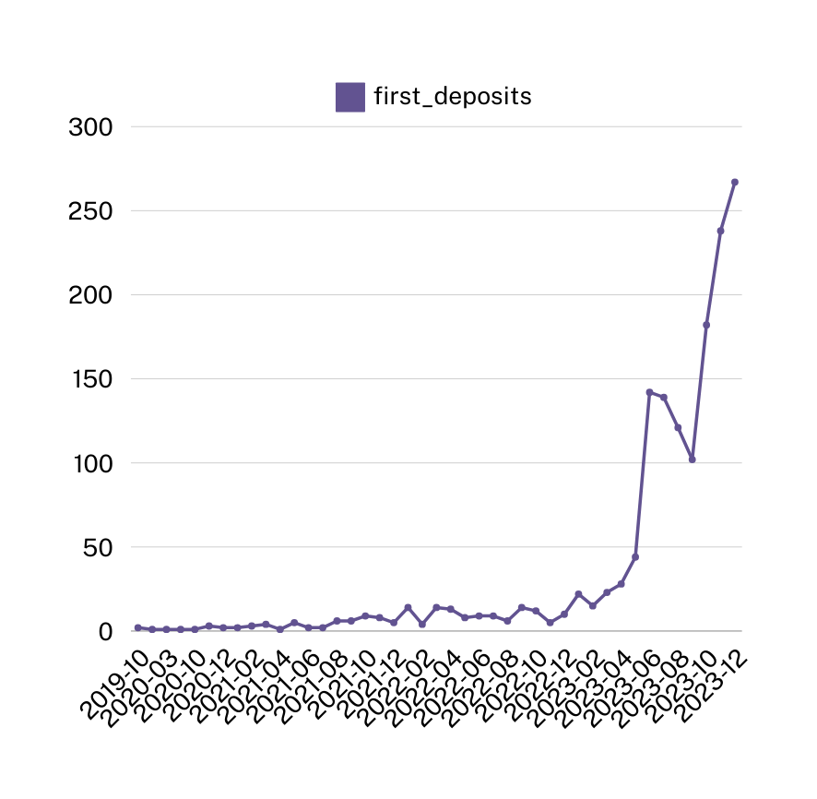
User Acquisition Over Time (H2 2023)

Slide 4
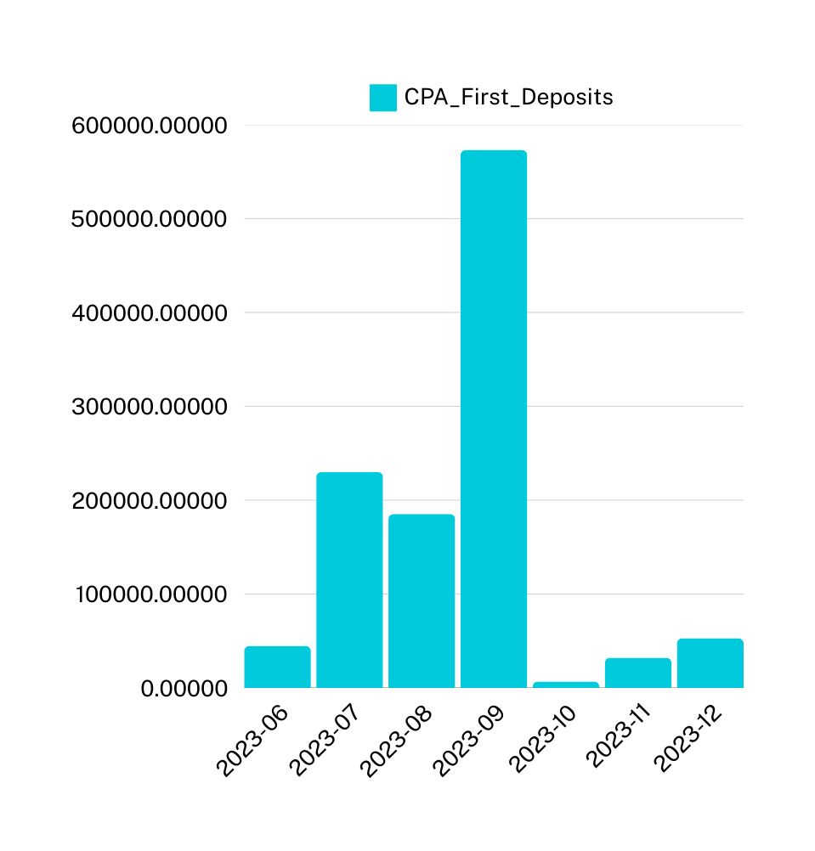
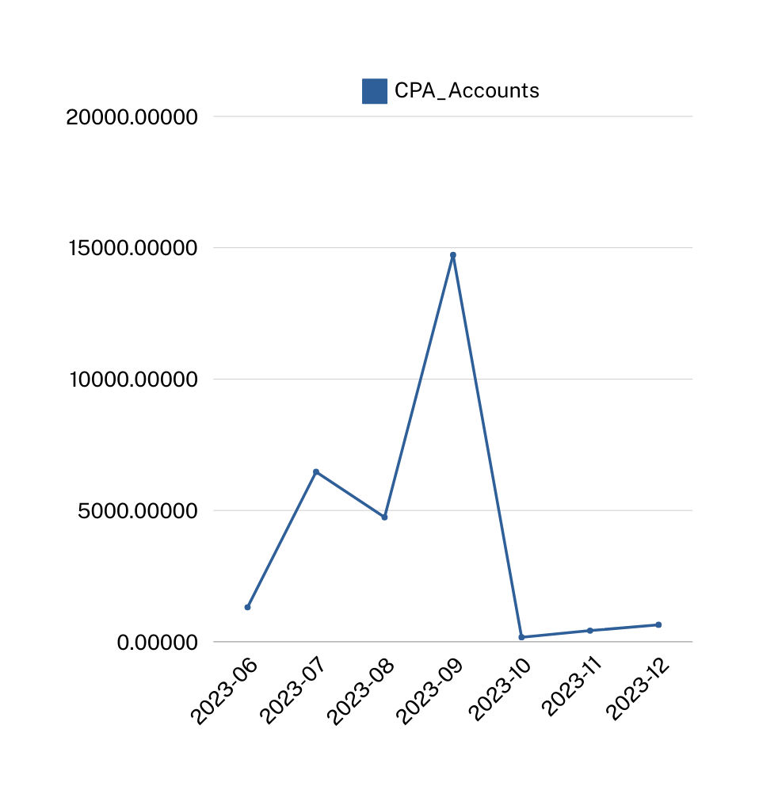

Slide 5
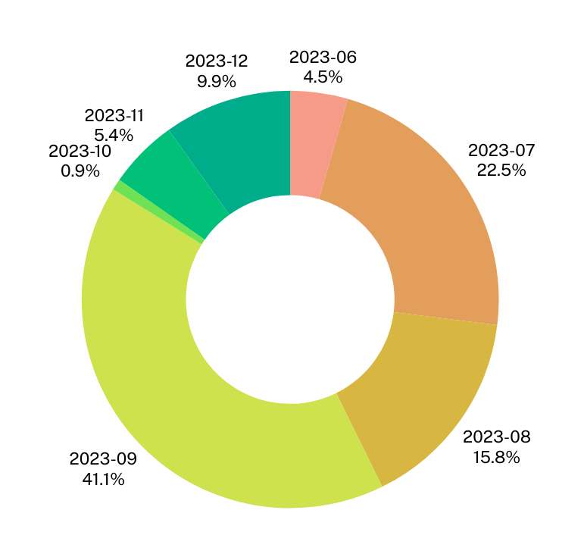
What the Data Tells Us
Marketing spend appears to directly correlate with increases in accounts opened and first deposits in certain months.
The CPA for accounts opened and first deposits may indicate areas for optimization.
Focus marketing efforts during months with the highest user acquisition.
Investigate periods with higher CPAs to improve cost-efficiency.

Slide 6
LookingAhead
01
Optimize marketing spend during high-performing months.
Experiment with new channels to reduce CPA.
Assess the effectiveness of different marketing channels.
Conduct A/B tests on marketing campaigns.
02

